Slide 1
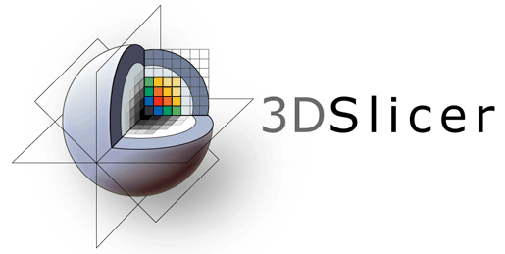
3D Slicer Data Loading and Visualization Tutorial

Slide 2
Tutorial dataset
Please download the following two datasets:
https://github.com/PerkLab/PerkLabBootcamp/raw/master/Data/VisualizationTutorial_HeadScene.mrb

Slide 3
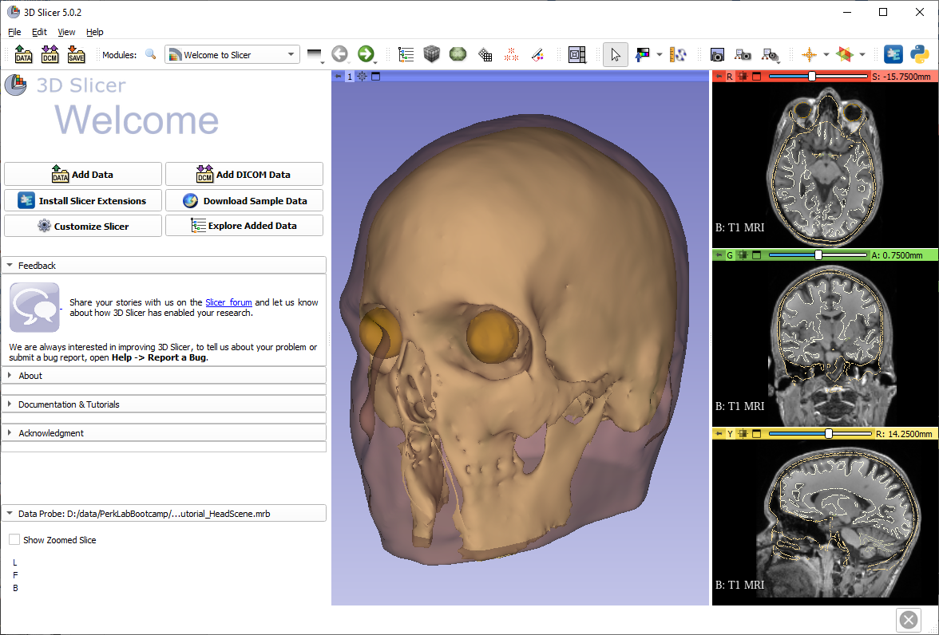
Main user interface
3D view
Slice views
Module panel
Data probe

Slide 4
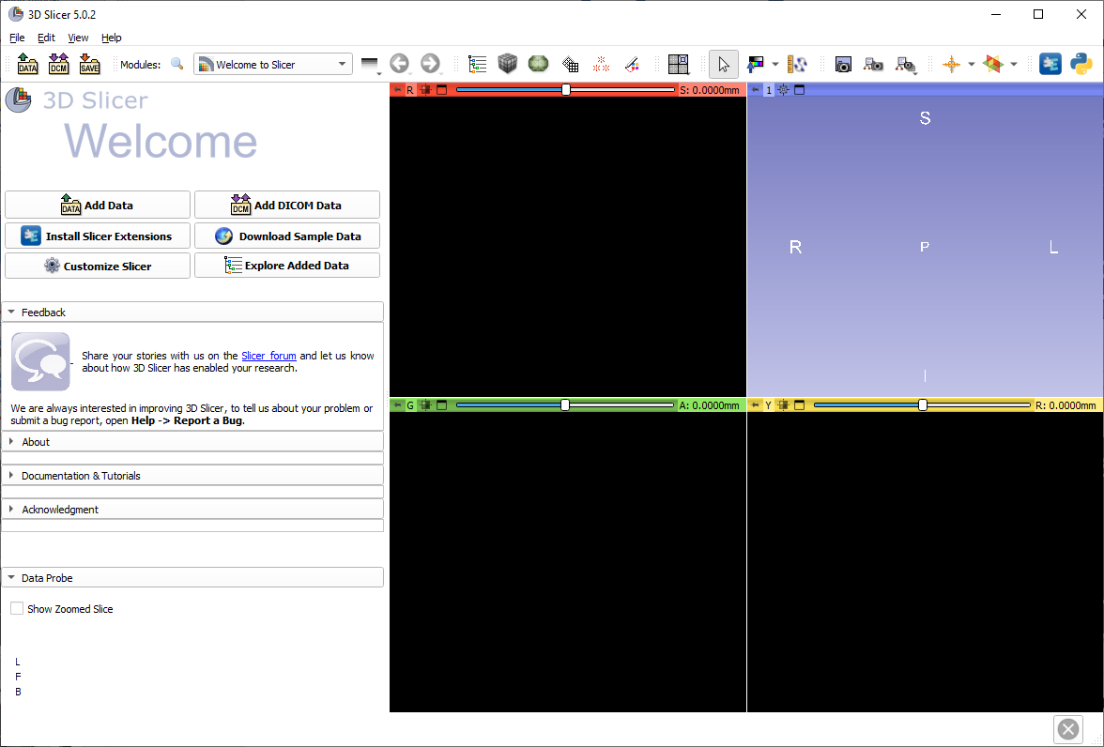

Load sample MRI data

Slide 5
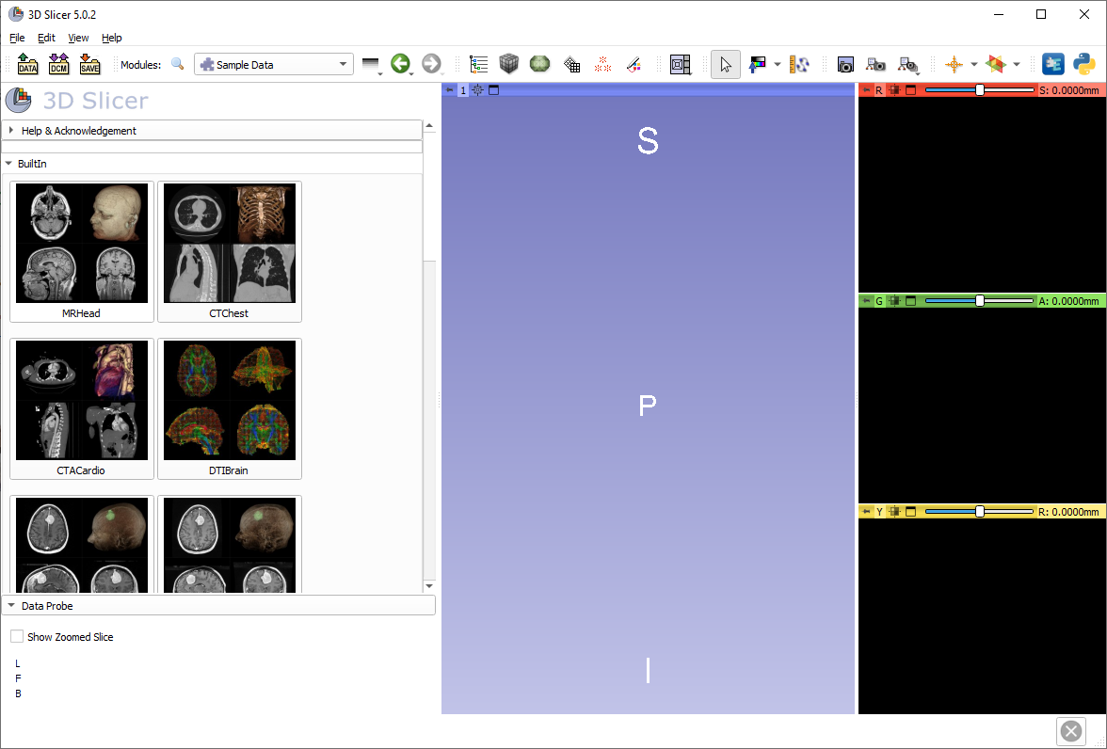
Load sample MRI data

Slide 6
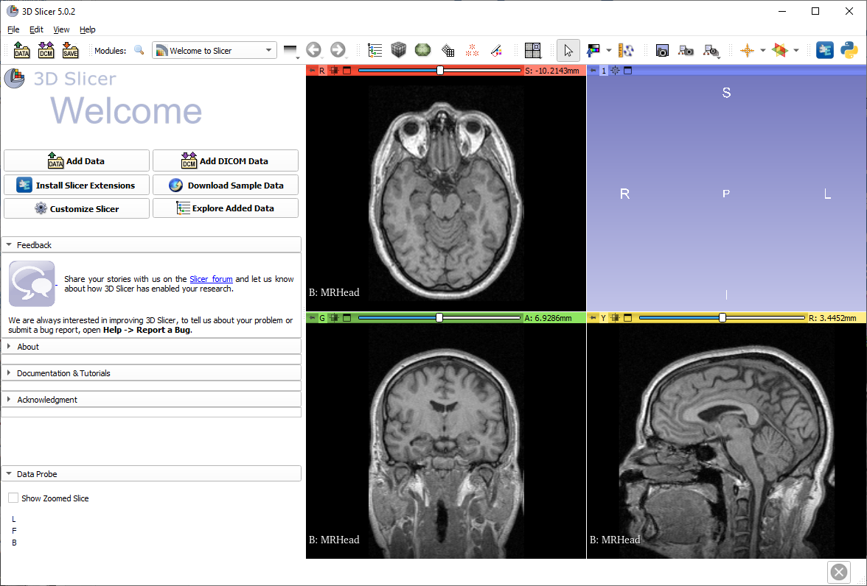
Load sample MRI data
The axial, sagittal, and coronal views automatically show the loaded volume

Slide 7
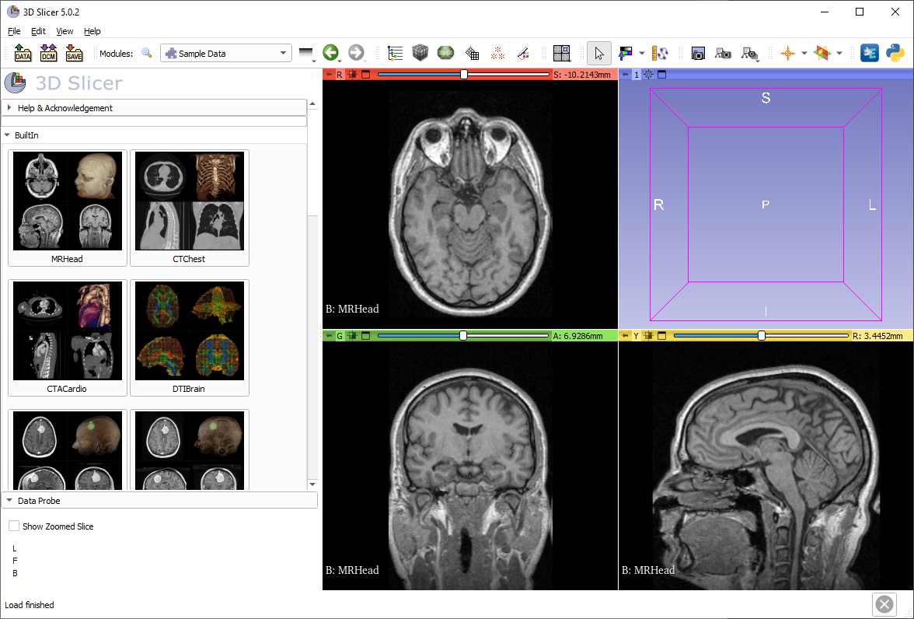
Adjust window/level
Switch to window/level mouse mode

Slide 8
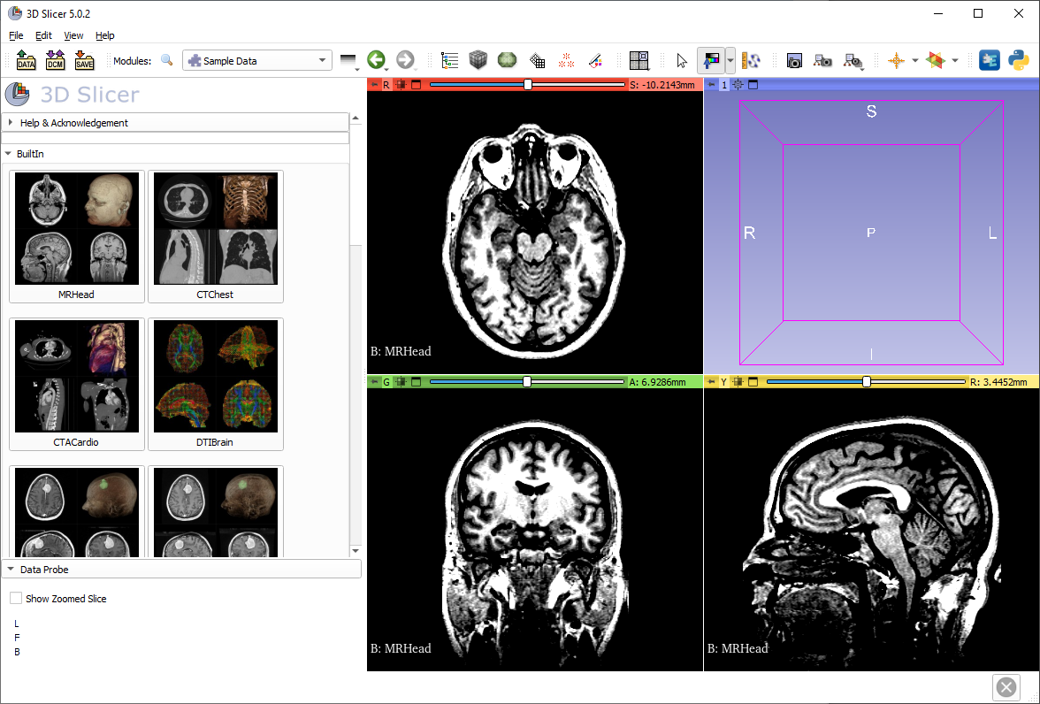
Adjust window/level
Adjust window/level (brightness/contrast) using the left mouse button on a slice view

Slide 9

Switch back to view/transform mode

Slide 10

Maximize view
Click on the maximize view button

Slide 11
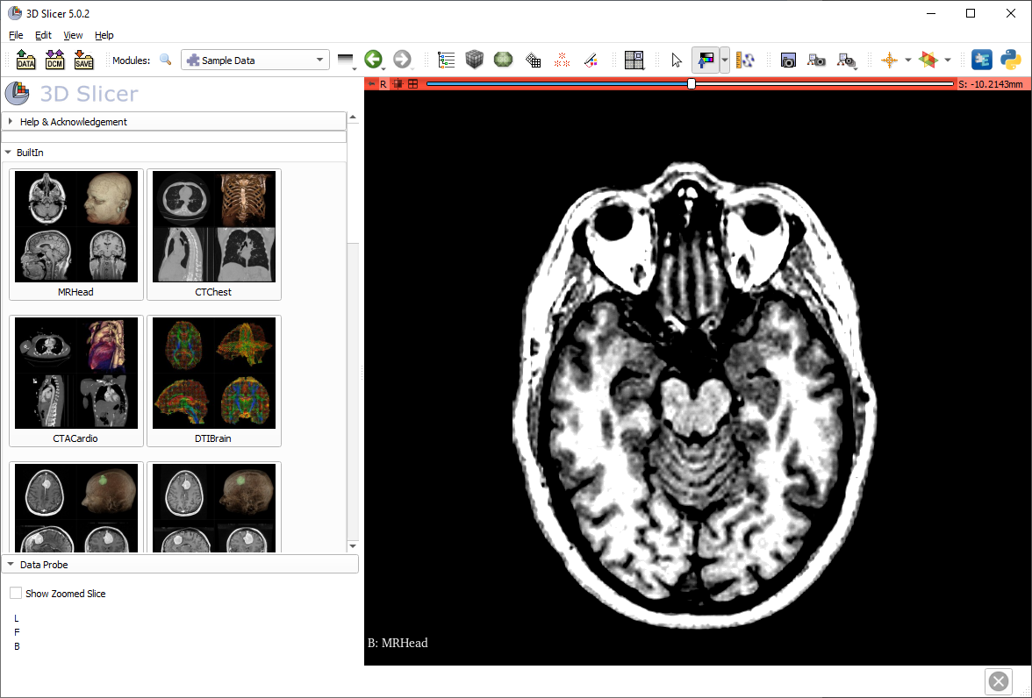
Slice view options
Position your mouse cursor over the pin icon to display the slice view toolbar

Slide 12
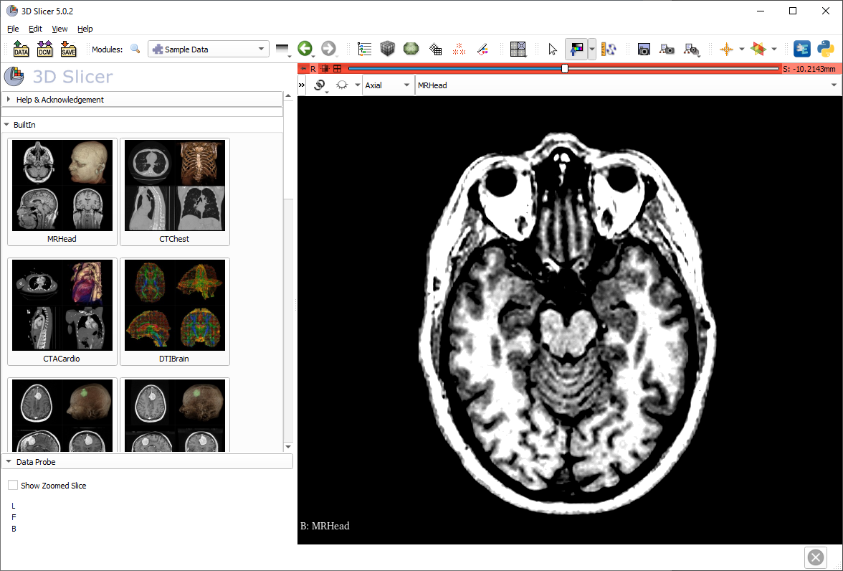
Slice view options
Once the slice viewer toolbar is shown, click on the “>>”

Slide 13
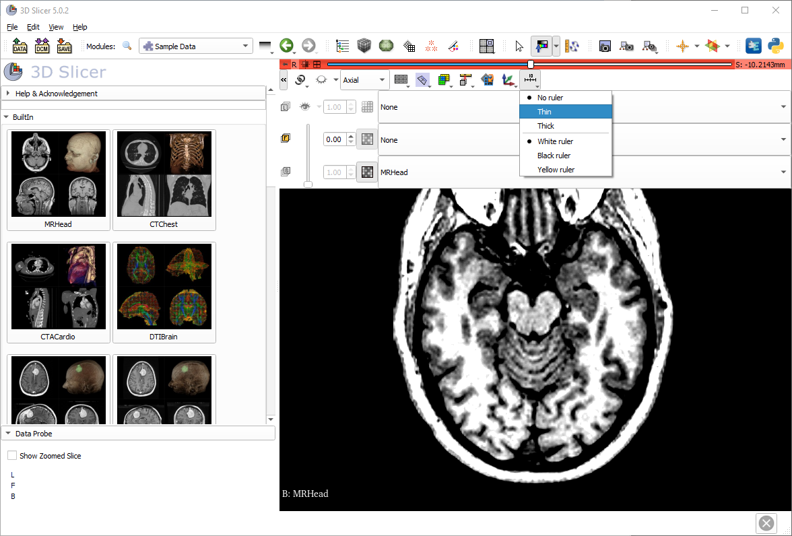
Show ruler

Slide 14
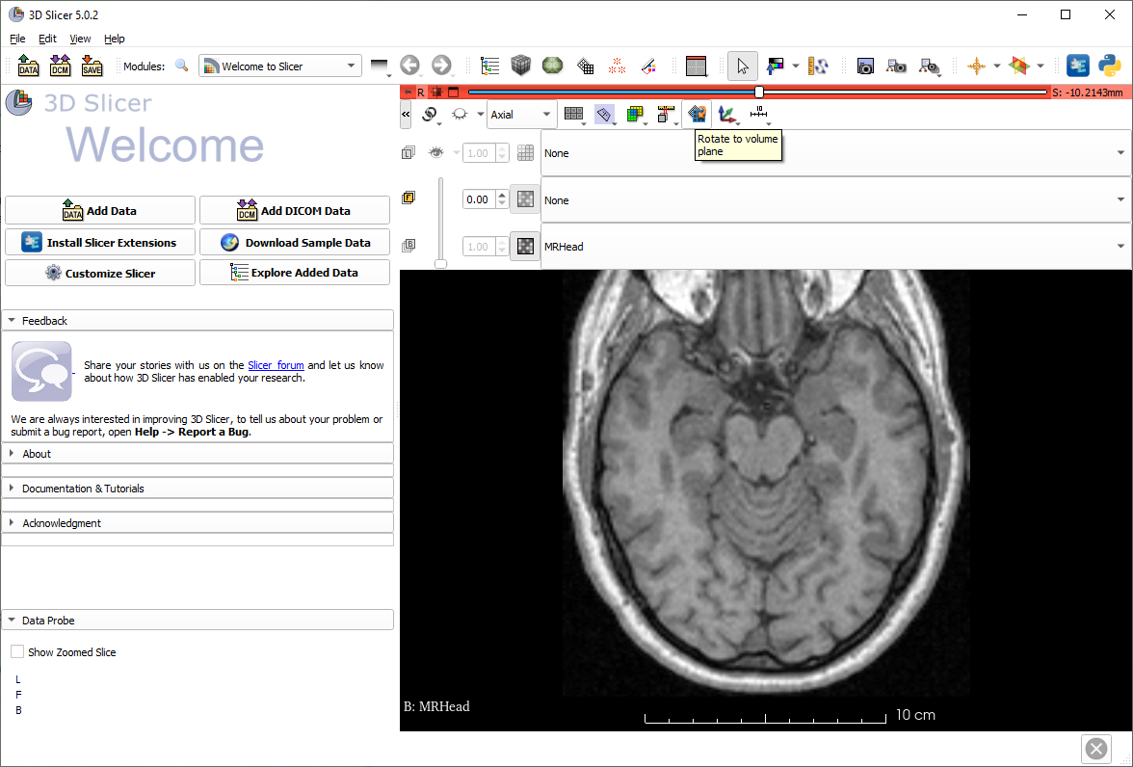
Rotate to volume plane
Often, MRI volumes are not axis-aligned. To show the true axial view, click the ‘Rotate to volume plane’ button.
Note: This image will not be affected, but many DICOM MR images need to be aligned.

Slide 15
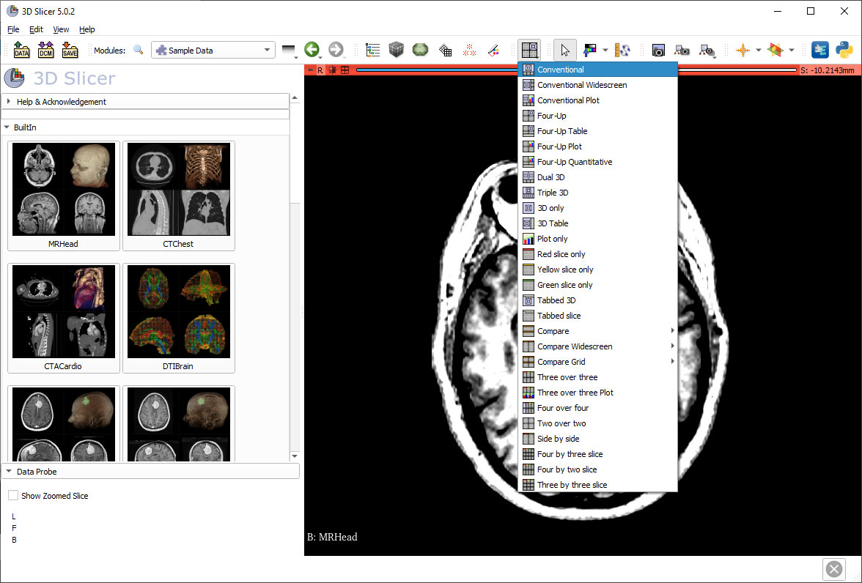
Switch to conventional layout

Slide 16
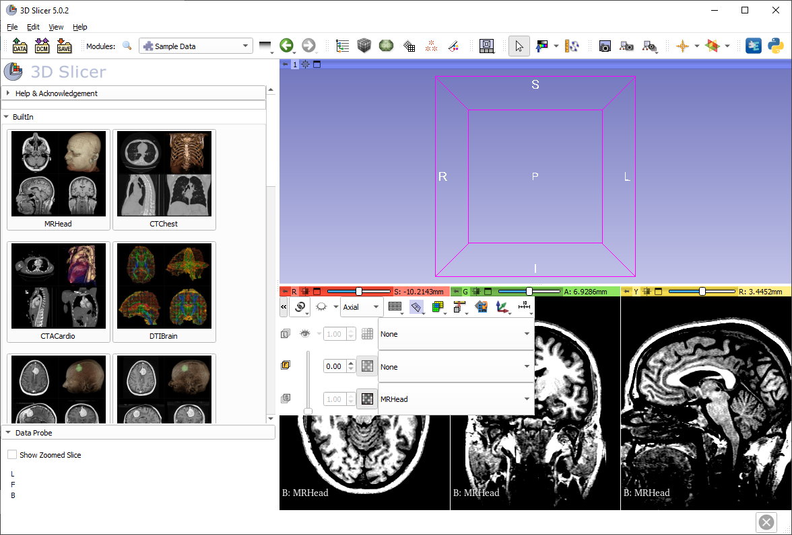
Link views
After linking views, if any setting is changed in a 2D view, all others follow.

Slide 17

Show slices in 3D
Now the slice views are linked. If you click the ‘Toggle slice visibility in 3D view’ button, then all slices will show up.

Slide 18
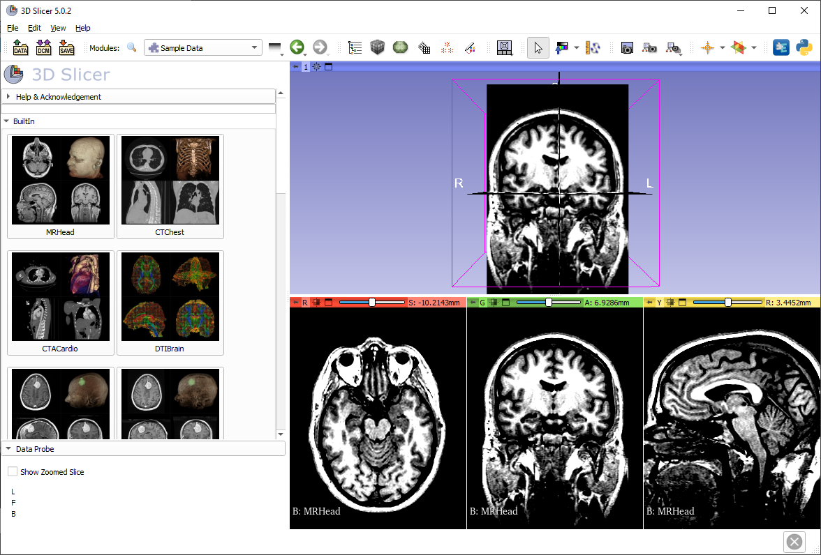
Show slices in 3D
All three anatomical slices are shown in the 3D view

Slide 19
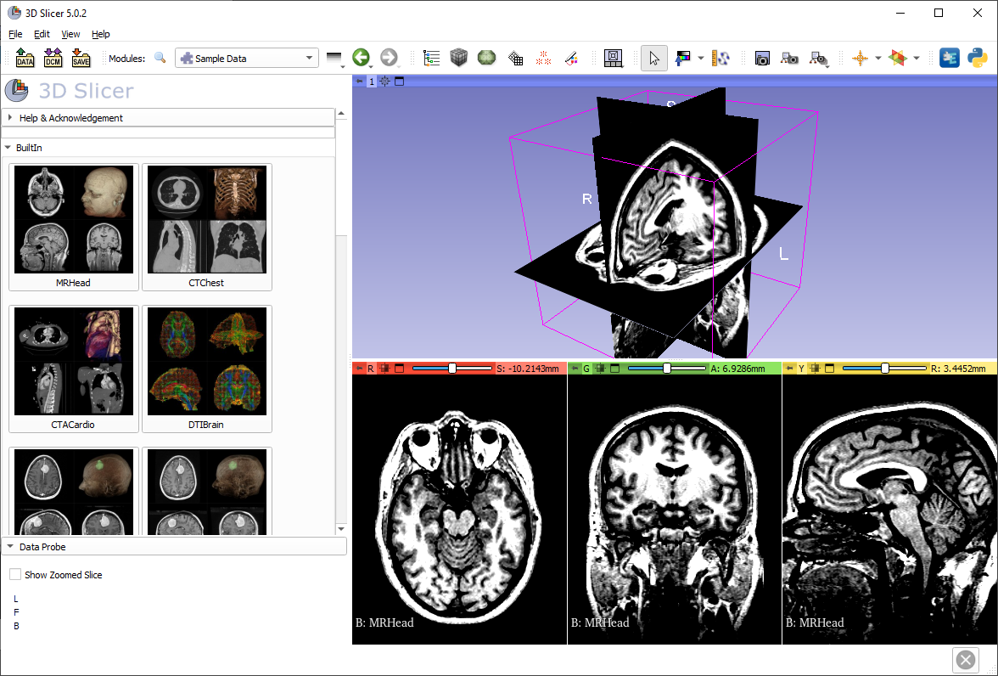
Navigating the 3D view
Use the left mouse button to rotate, and the right mouse button to zoom in and out

Slide 20
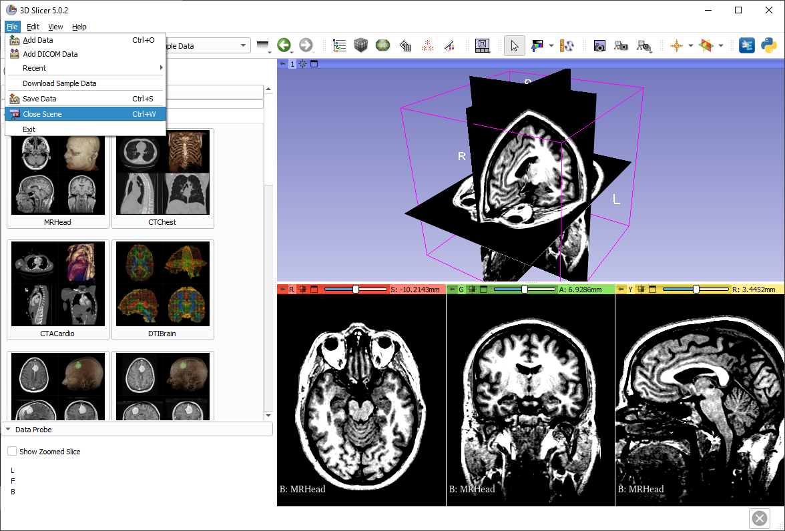
Close the scene

Slide 21
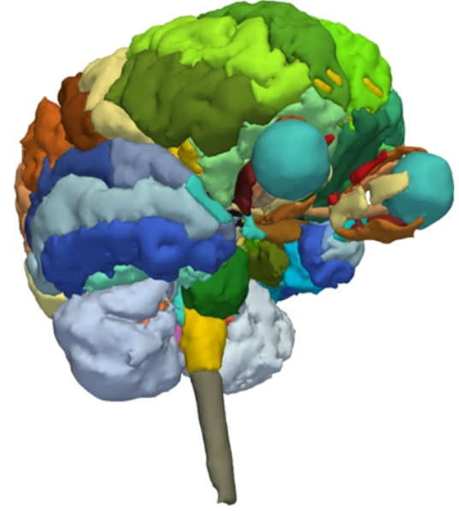
Part 2: 3D visualization of surface models of the brain

Slide 22
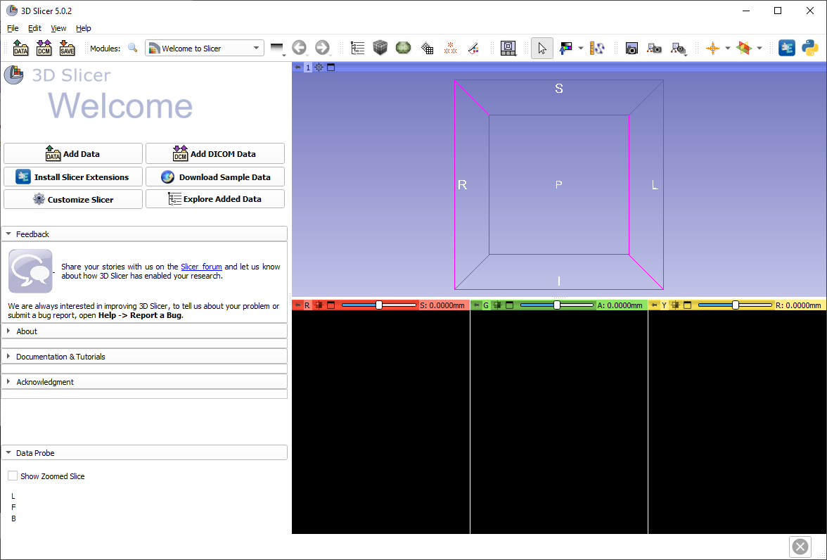
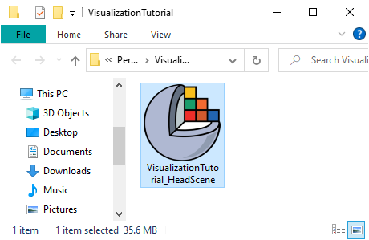
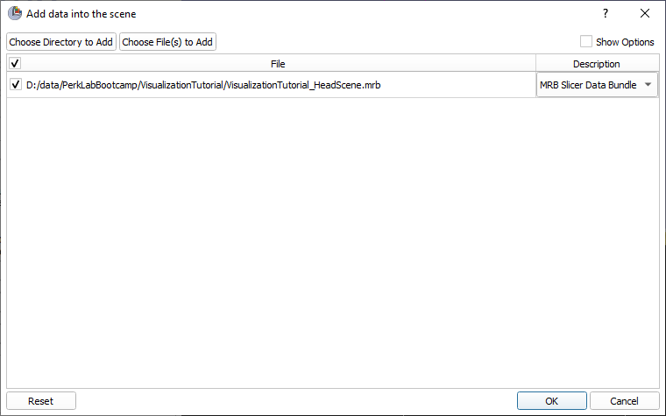
Load tutorial scene
Drag and drop the file VisualizationTutorial_HeadScene.mrb into Slicer, then click OK

Slide 23

Center view
Click on the small box icon to center the view, in 3D or in 2D

Slide 24
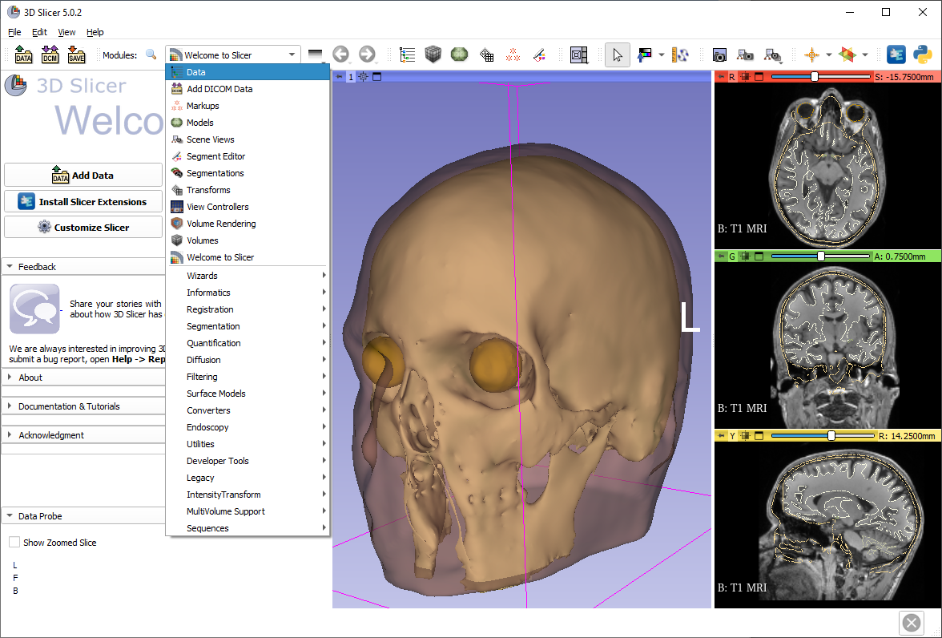
Explore loaded data
You can use the module list, or the favorite module toolbar to switch to the Data module

Slide 25
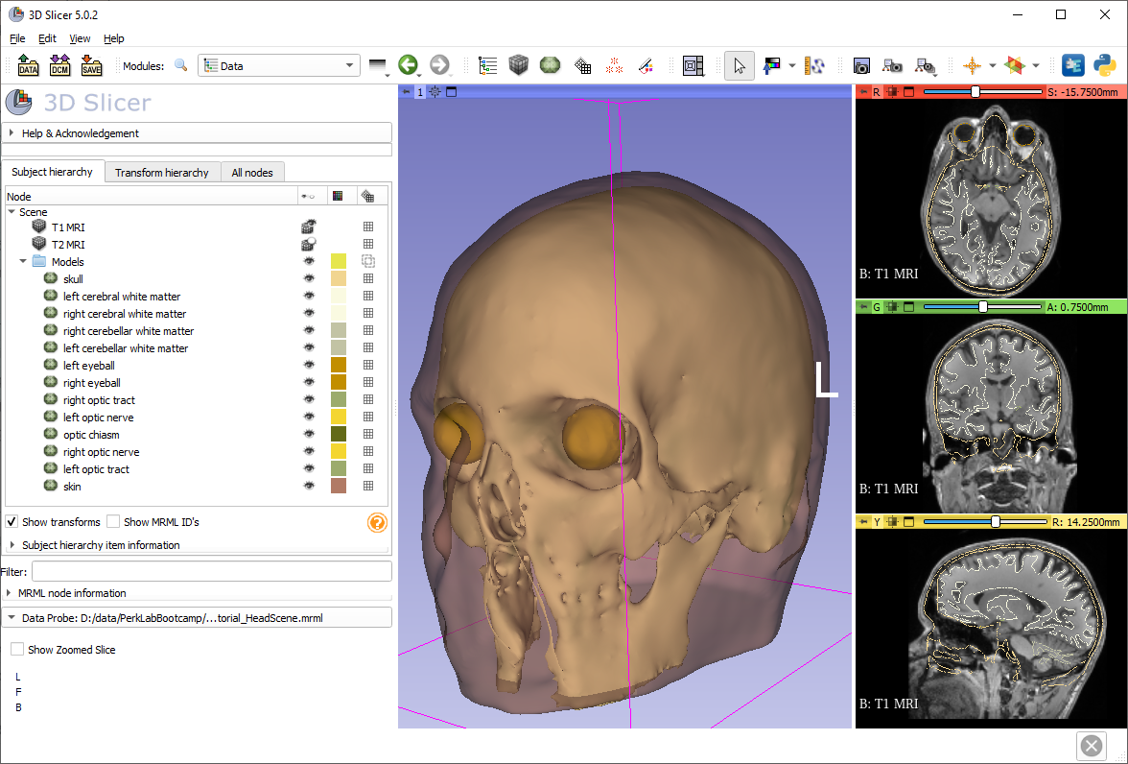
Explore loaded data
The Data module shows all the data in the scene.
The data items (“nodes”) can be shown/hidden, renamed, deleted, cloned, etc.
Hide the ‘skin’ model by clicking the eye icon.

Slide 26
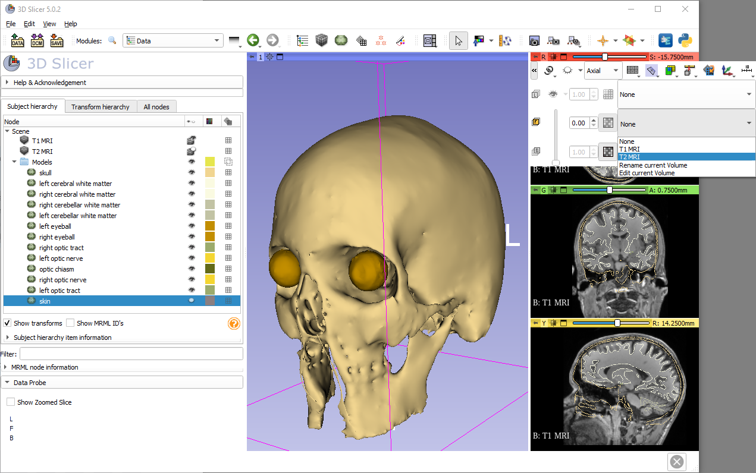
Foreground image
Images can be overlaid (“fused”) by setting the foreground image.
Select ‘T2 MRI’ as foreground
Adjust foreground opacity using the slider

Slide 27
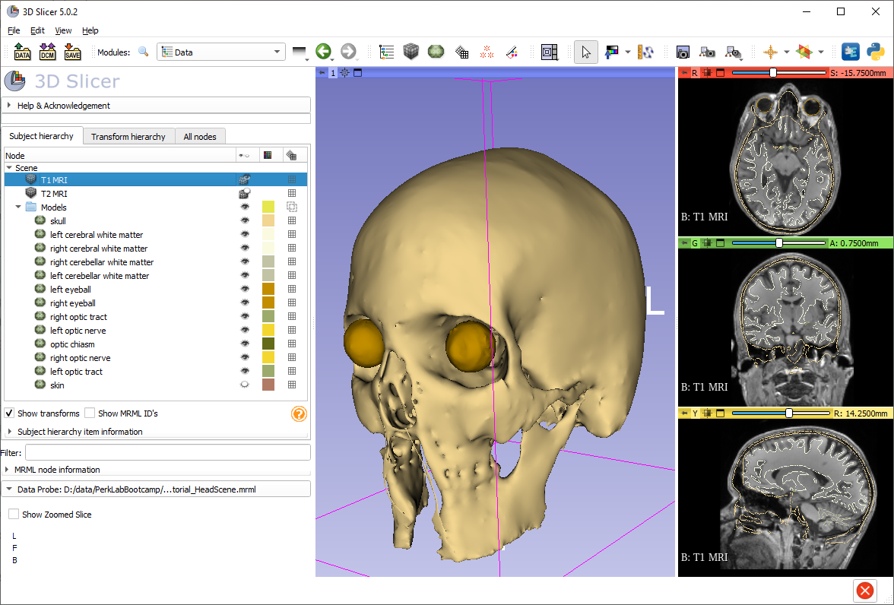
Subject hierarchy
For list of “subject hierarchy” options for a certain node, right-click it in the list. Note that the options are different for each node type.
Right-click the volume called ‘T1 MRI’.

Slide 28

Node actions
Choose the Rename option and rename the volume to ‘T1 MRI brain’

Slide 29
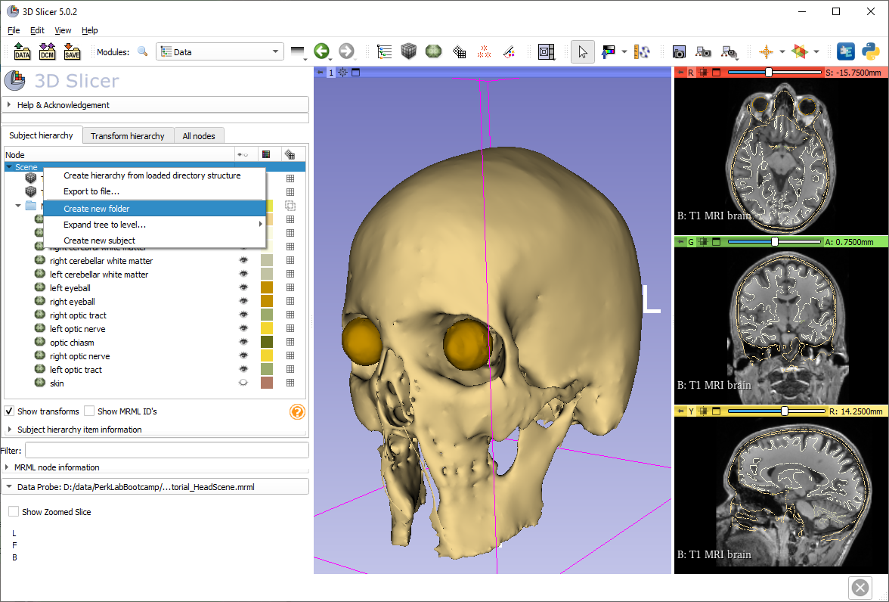
Create folder
Right-click the scene (or the empty area on the bottom), then choose ‘Create new folder’.

Slide 30
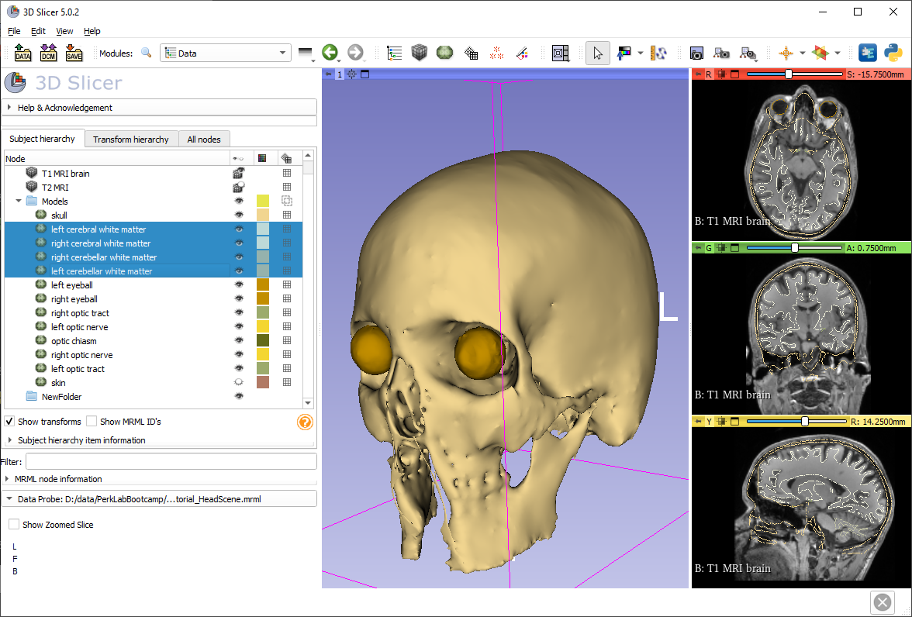
Select multiple nodes
Click ‘left cerebral white matter’, hold down Shift, and click ‘left cerebellar white matter’.
Note: You can use Control/Cmd button to select individually.

Slide 31

Move nodes to folder
Drag&drop models into the folder

Slide 32
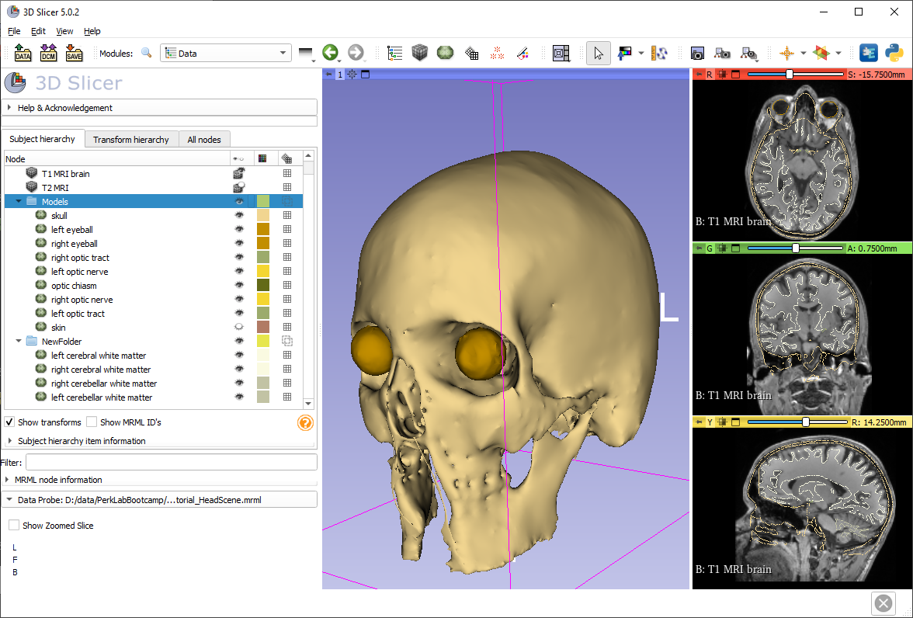
Hide all nodes in folder
Click the eye icon of the ‘Models’ folder to hide all non-brain structures.

Slide 33
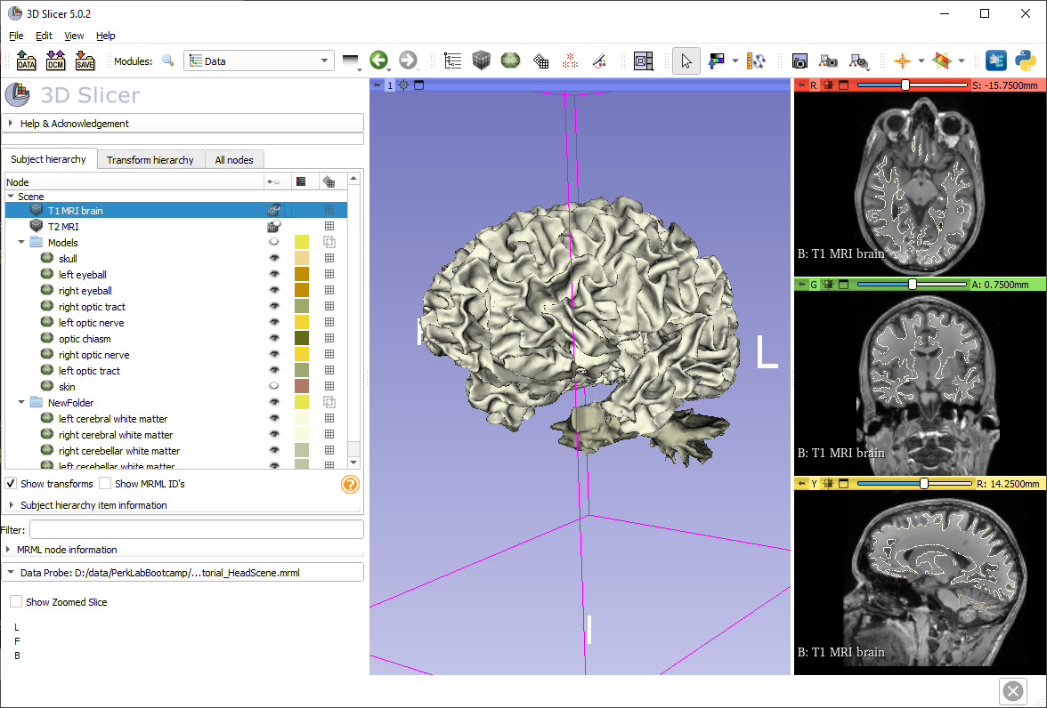
Volume rendering
Click&drag volume to the 3D view.

Slide 34
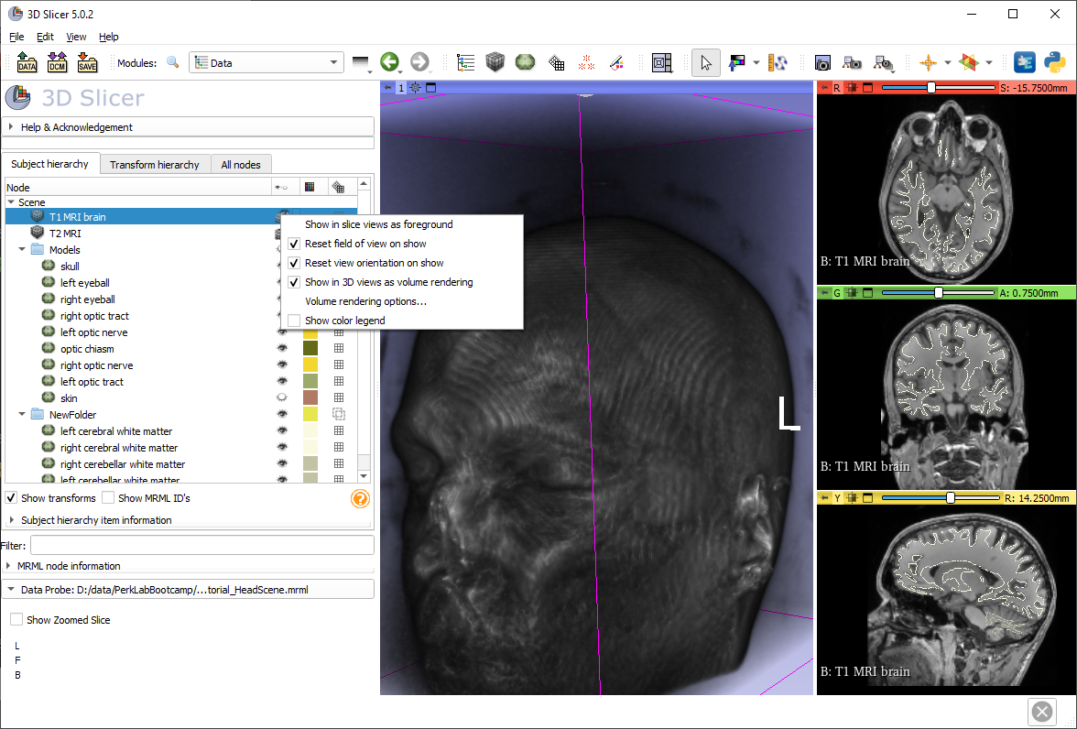
Display options
Right-click the eye icon to see display options. Choose ‘Volume rendering options…’. (It switches to the Volume Rendering module)

Slide 35
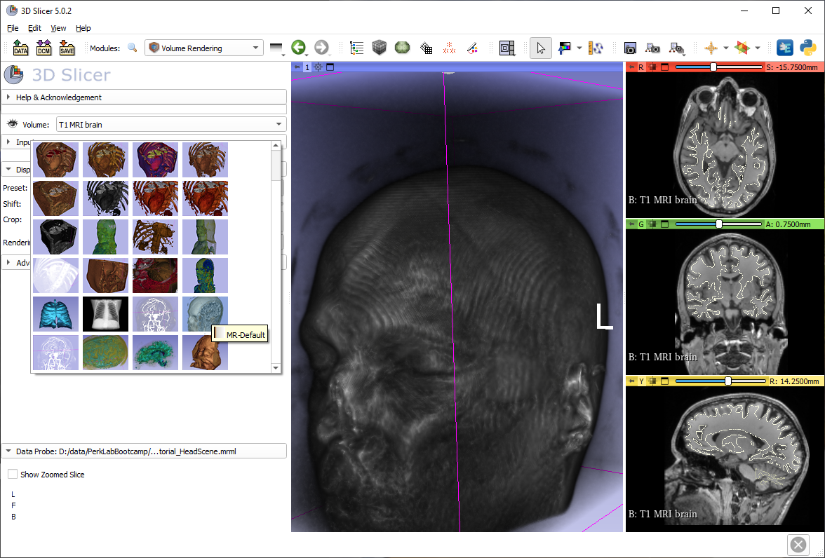
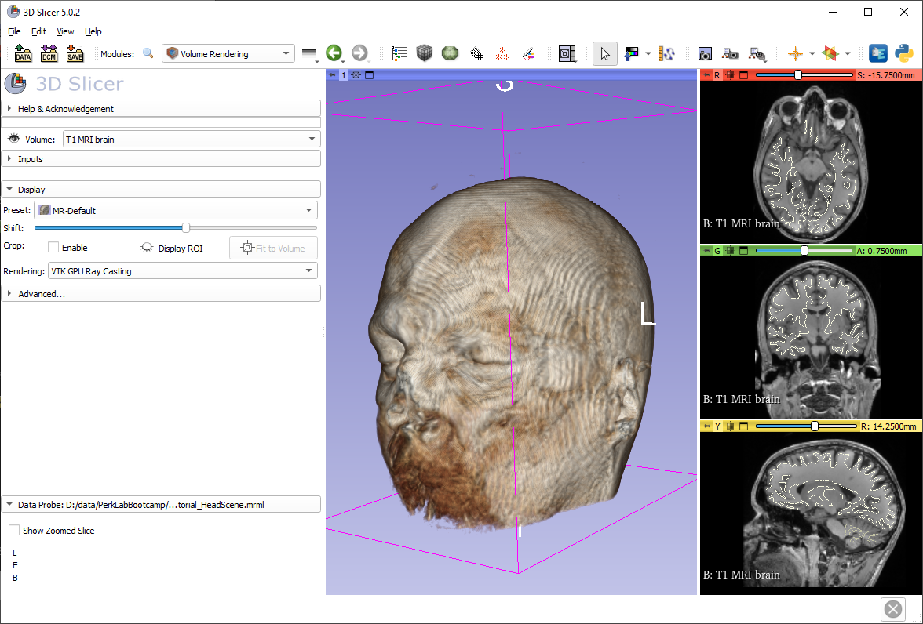
Adjust volume rendering
Click on ‘Select a Preset’ and choose MR-Default.
Adjust the Shift slider to optimize visualization.

Slide 36
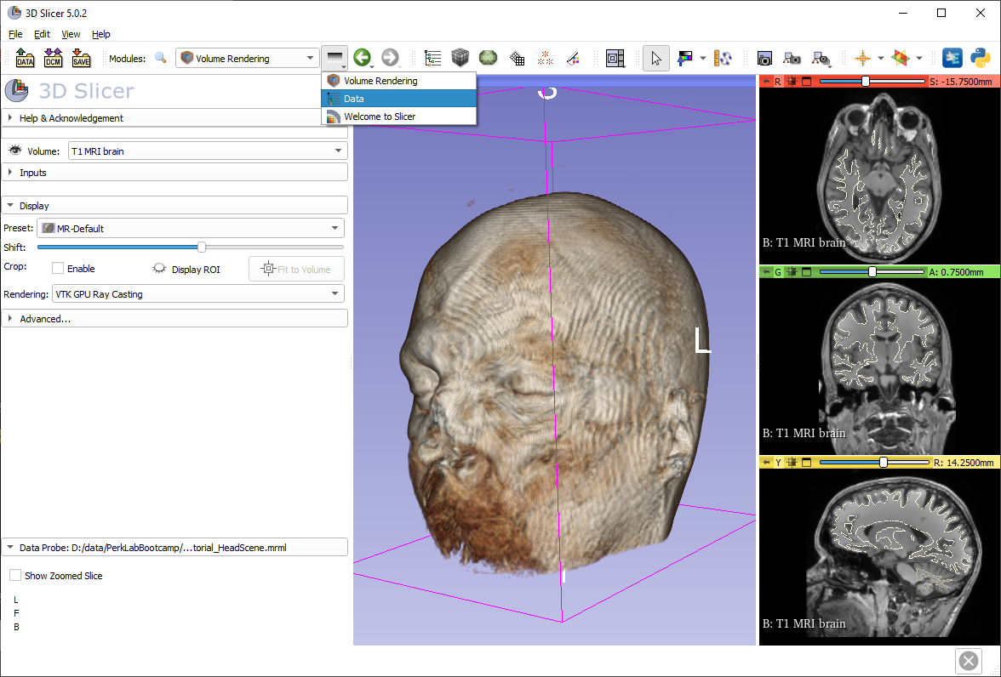
Show models again
Turn off volume rendering using the eye icon.
Switch back to the Data module using the Modules history.

Slide 37
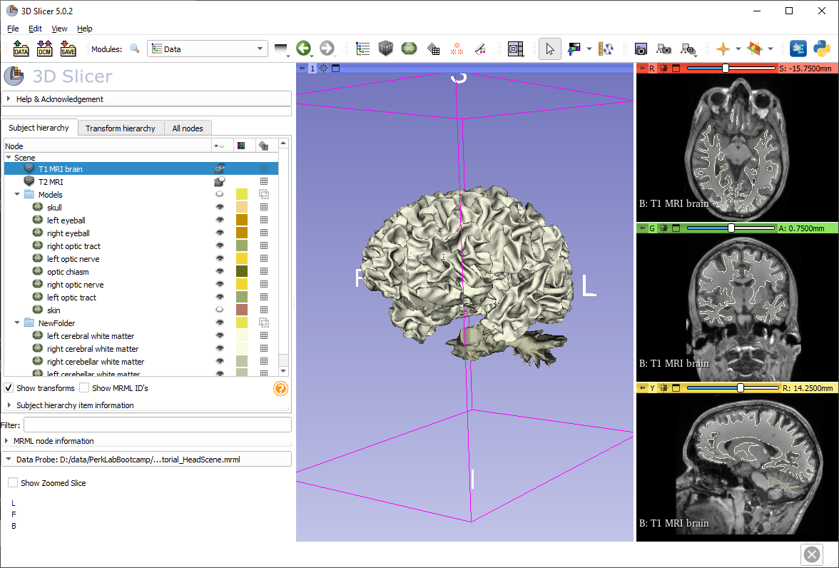
Show models again
Show the folder again by clicking the closed eye icon in its row.

Slide 38
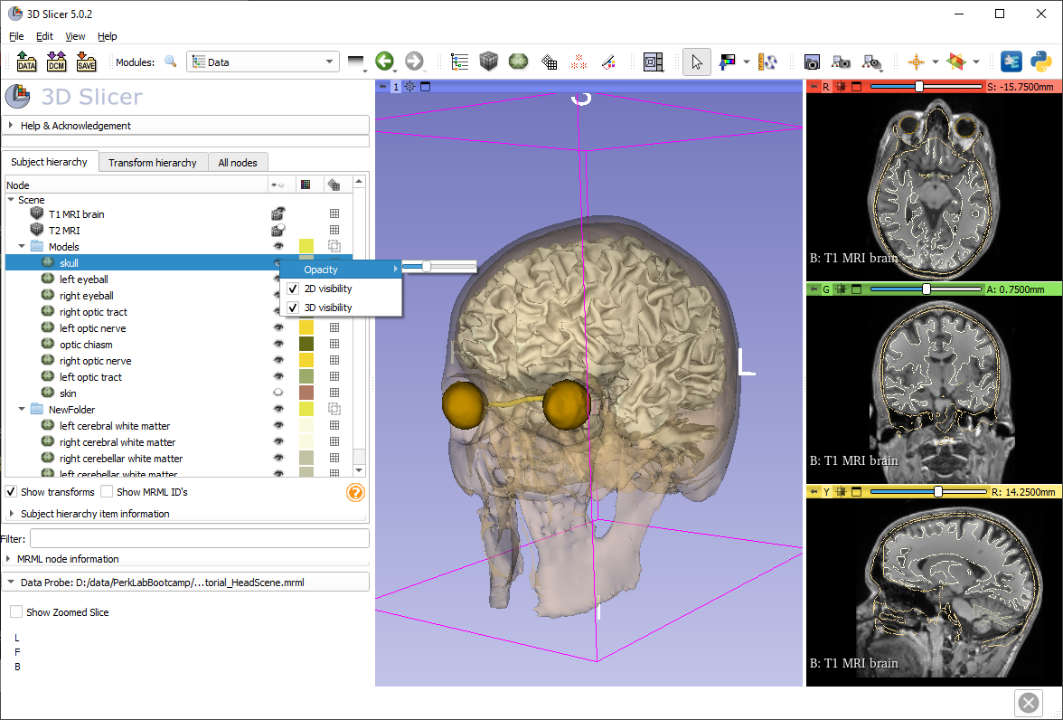
Change skull model opacity
Right-click the eye icon of the skull model, select Opacity, and adjust the slicer to around 0.30

Slide 39
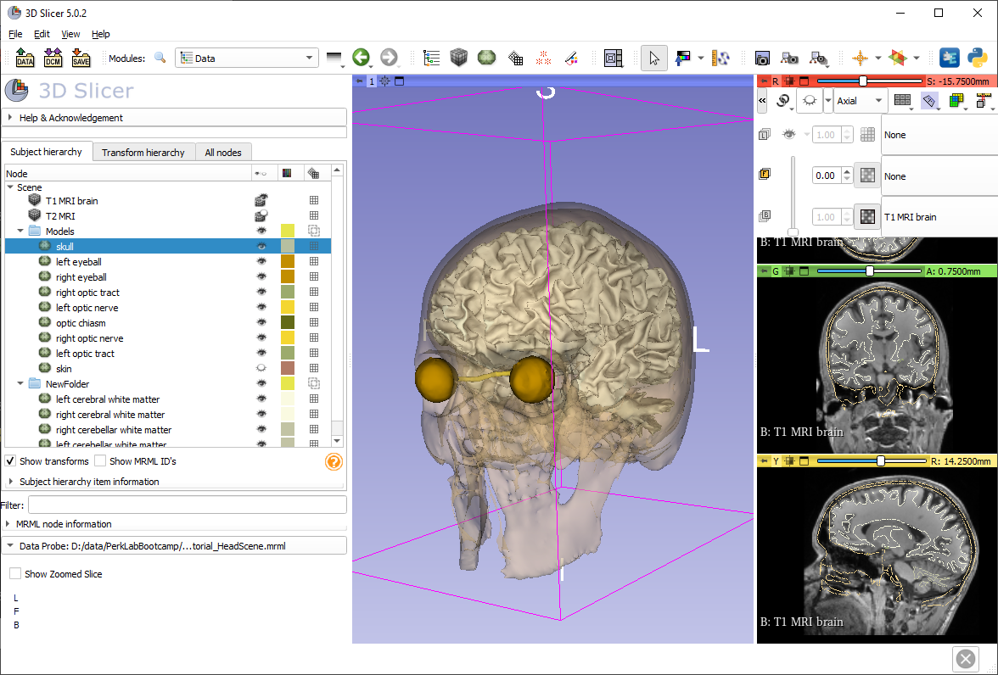
Show axial slice in 3D
Hover the push-pin icon and then the eye icon to show a slice view in 3D view.

Slide 40
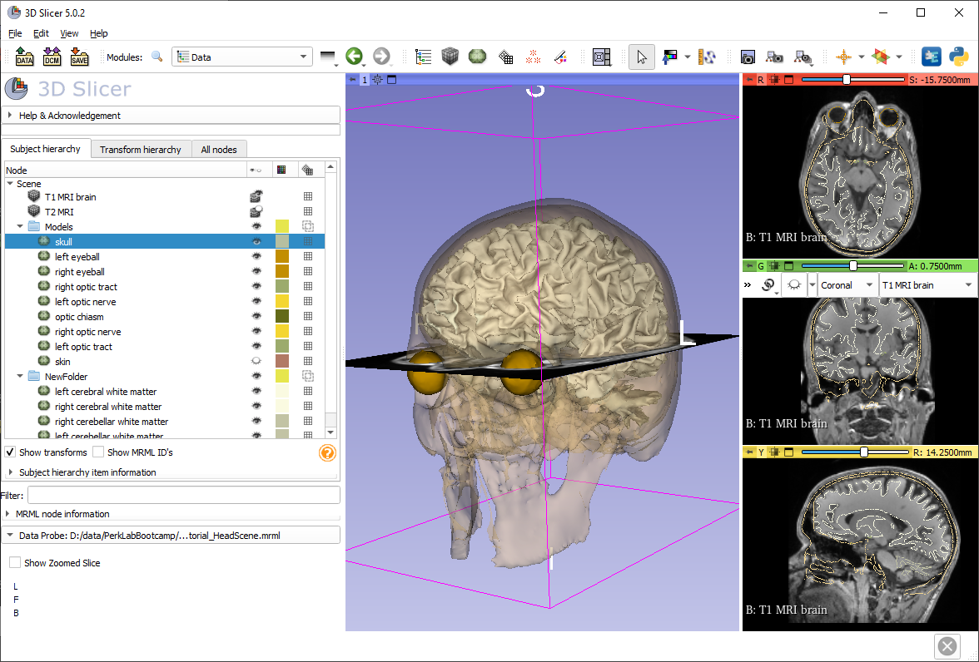
Show coronal slice in 3D

Slide 41
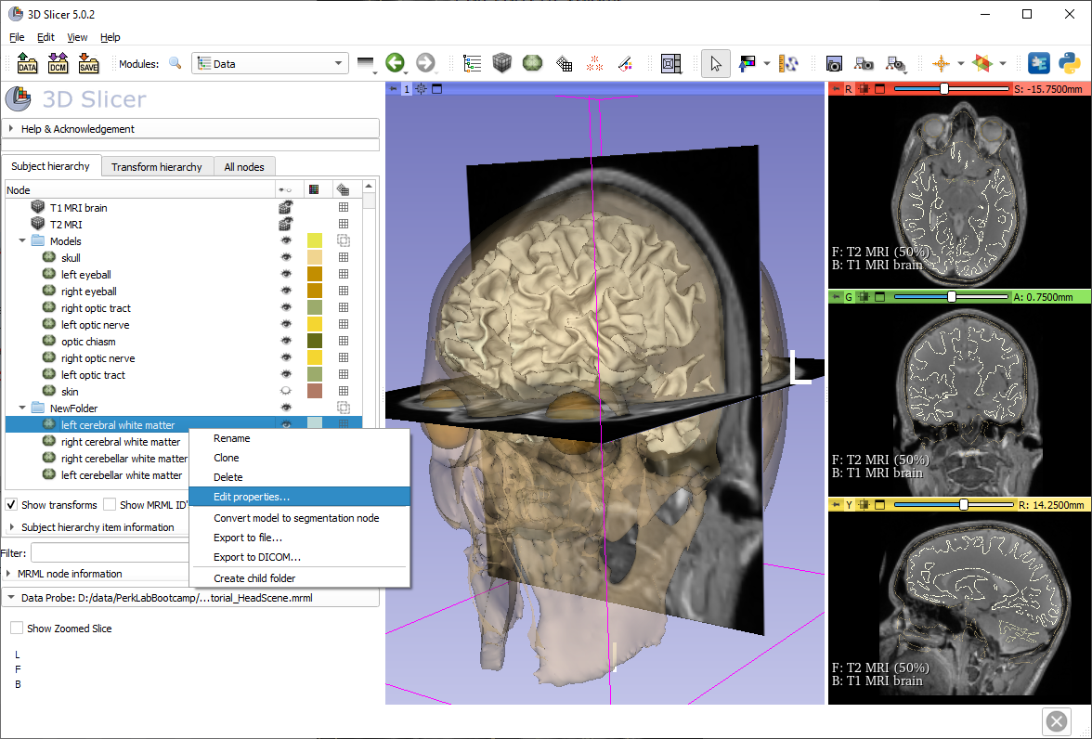
Model clipping
Right-click a model node in the data tree and choose ‘Edit properties…’ to go to the Models module. (It can be accessed from the toolbar or the module list as well)

Slide 42
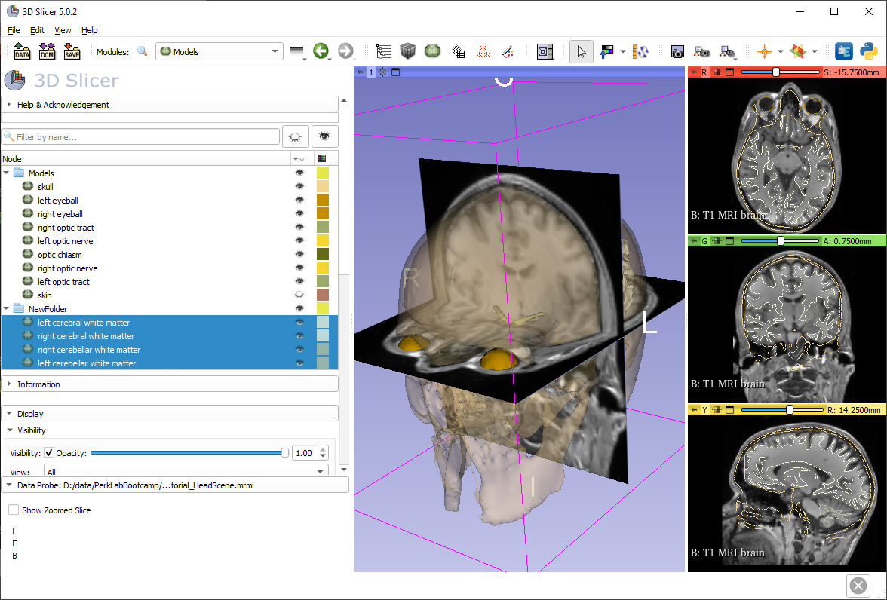
Model clipping
Select all brain models using Shift, then scroll down to the 3D Display section.

Slide 43
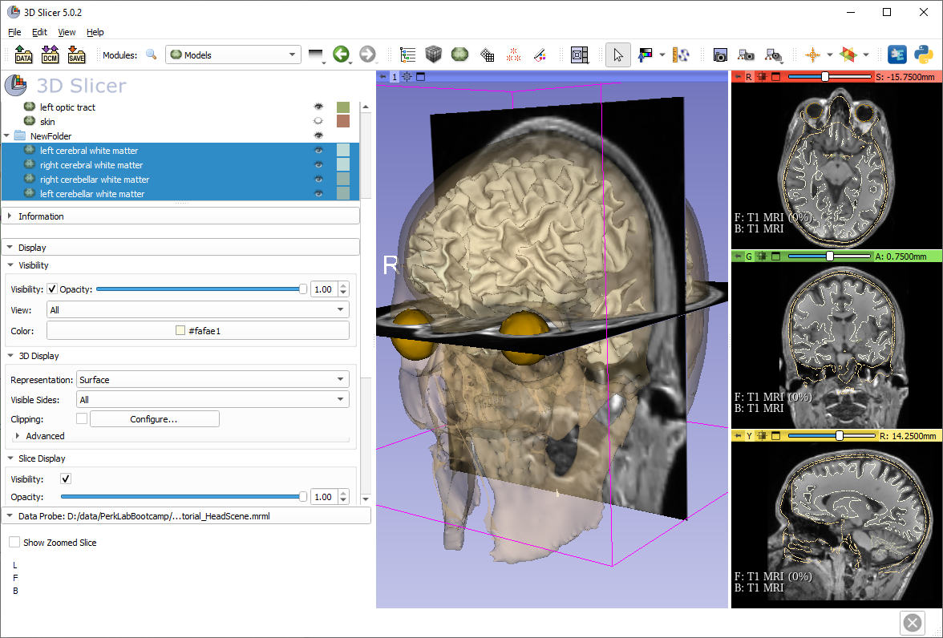
Model clipping
Turn on Clipping.
Click Configure.

Slide 44
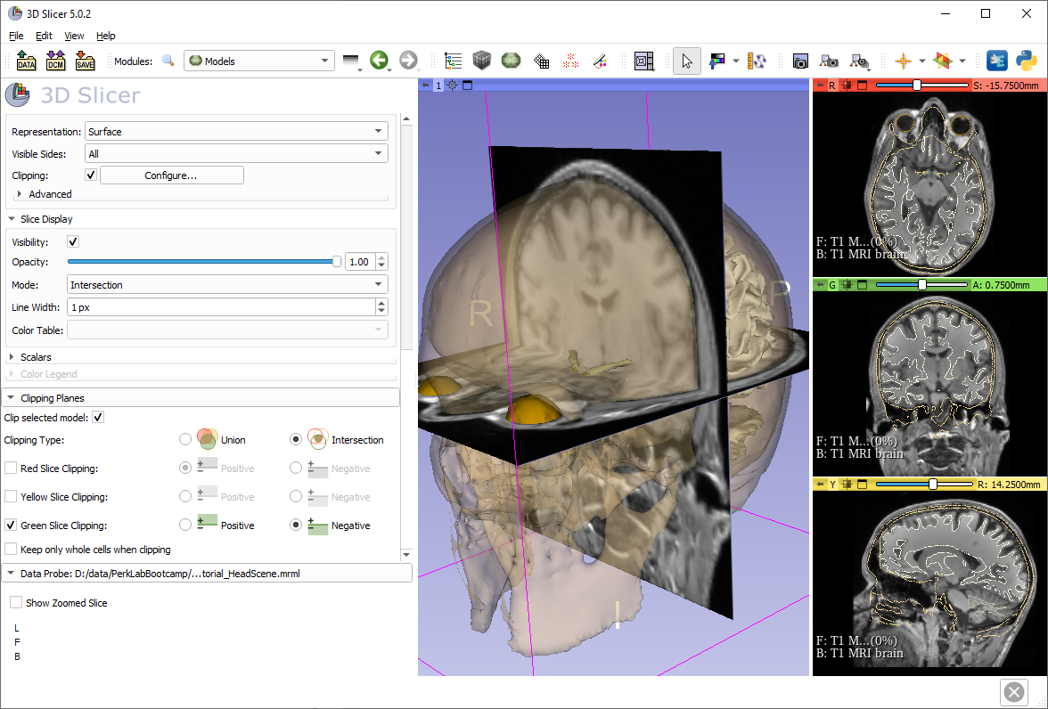
Model clipping
Turn off Red Slice Clipping and turn on Green Slice Clipping.
The optic chiasm becomes visible in the 3D view

Slide 45
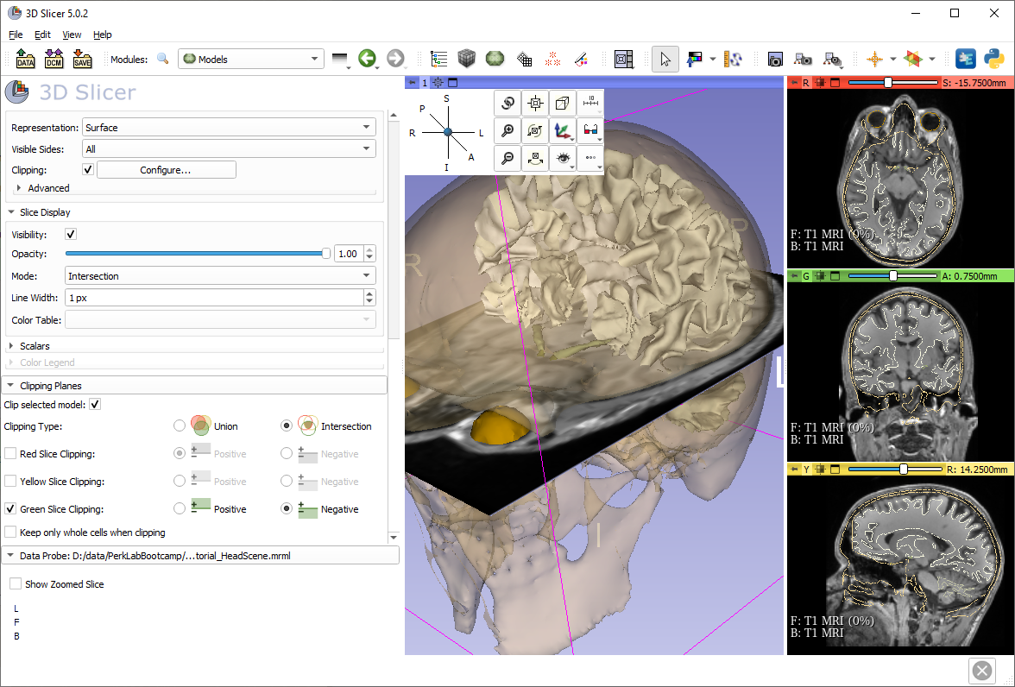
3D display options
Hide the coronal (green) plane. Position your cursor over the pin icon in the 3D view to display the 3D display options. Select the A (Anterior) view.

Slide 46
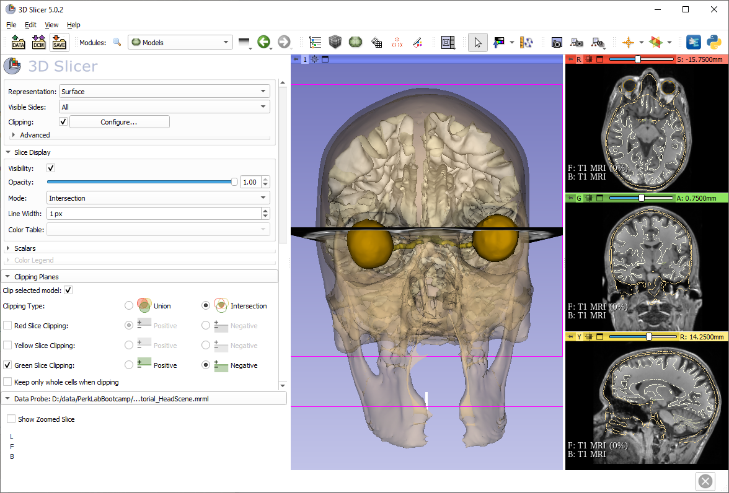
Save the scene
Click the ‘Save data’ button.
Note: Also accessible from the File menu

Slide 47
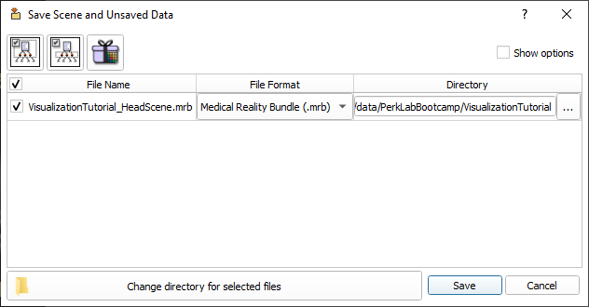
Save the scene
The Save Scene and Unsaved Data window lists all elements of the scene.
You can save as MRB bundle or as list of files.
Double-click the scene and rename it to myNewScene.mrb Click Save.

Slide 48
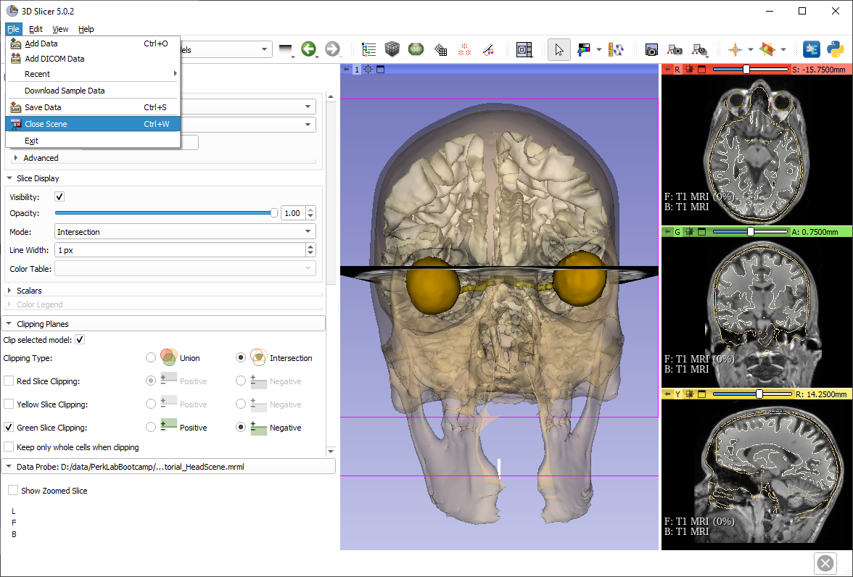
Close the scene

Slide 49
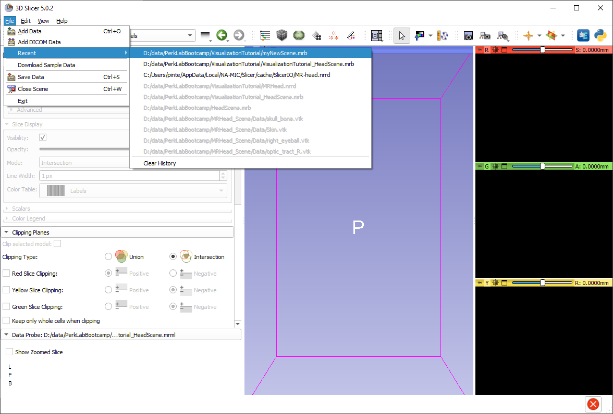
Load your recently saved scene
Load the new scene using the Recent data list.
(You can load the scene using drag&drop or Add data as well)

Slide 50
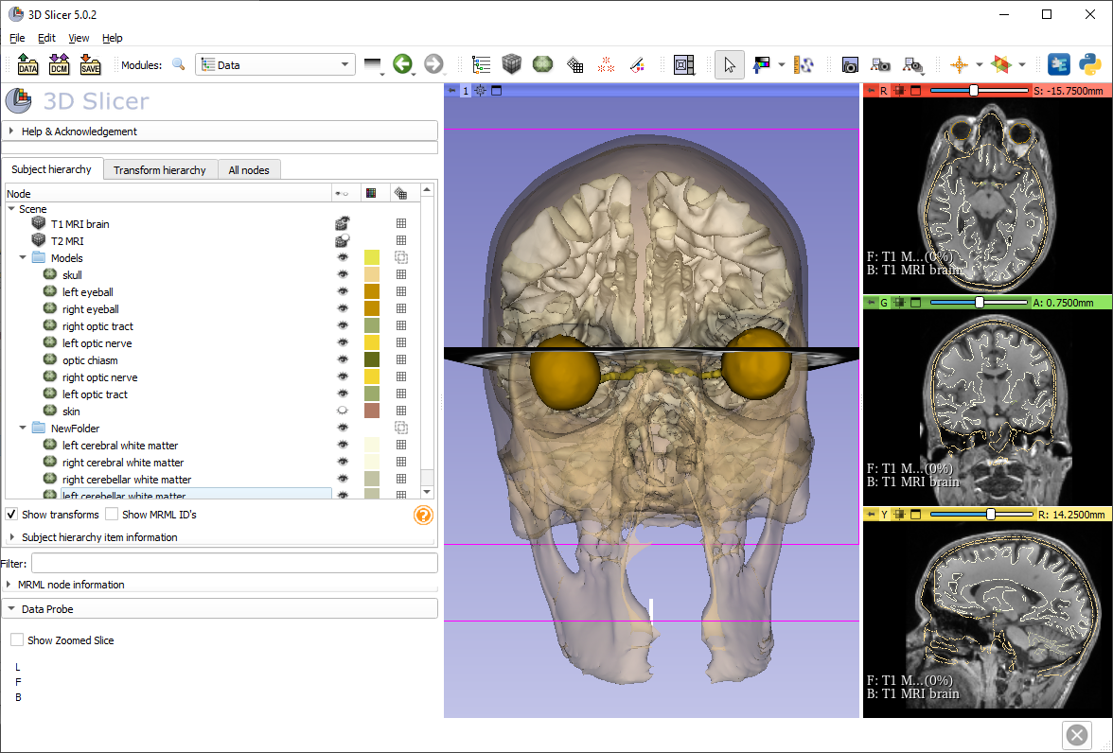
Thanks for participating!

